Slide 1
Daugman’s Algorithm

Slide 2
Introduction
The Daugman algorithm is widely used for iris recognition.
The Daugman algorithm was invented by John Daugman in the year 1991.
This algorithm has various applications and used by many government agencies for their security purposes.
Algorithm has 4 steps
Iris localisation – locating the Iris in an image
Iris Normalisation – Converting the circular iris region into rectangular image
Iris encoding
Iris matching

Slide 3
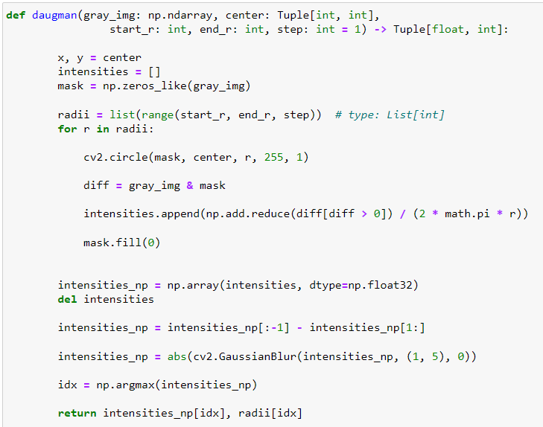
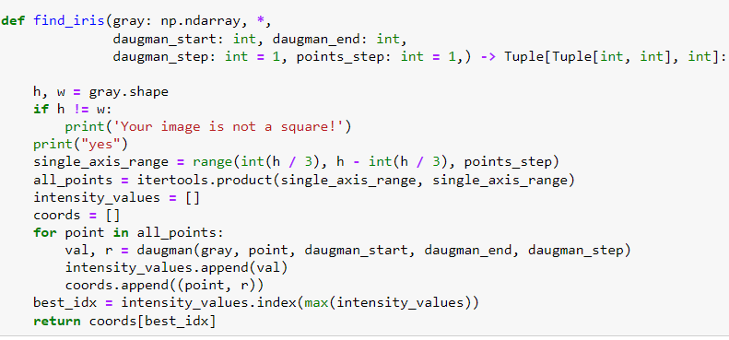
Daugman Algorithm code

Slide 4
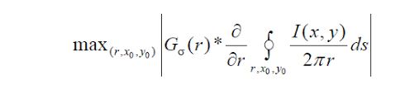
Daugman’s algorithm description
The main agenda of this is to find the iris and pupil radius center and radius.
The centre point of Daugman’s theory of border recognition is the integro-differential equation.
The integro-differential operator is based on the intensity difference between inside and outside of pixels in the iris edge circle is maximum.
I(x, y) is the intensity of the pixel at coordinates (x, y)
r denotes the radius of various circular regions
with the center coordinates at (x0, y0).
σ is the standard deviation of the Gaussian distribution.
Gσ(r) denotes a Gaussian filter of scale sigma (σ).
(x0, y0) is the assumed centre coordinates of the iris.
s is the contour of the circle given by the parameters (r, x0, y0)

Slide 5
Iris Localisation
First the input image is loaded using cv2 library and then it is converted into a gray scale image.
The gray scale image is then resized into a square image by giving the new dimensions.
After that find_iris() function is called which takes certain parameters they are
>> gray_image
>> daugman_start
>> daugman_stop
>> points_step
The above parameters are discussed more in the upcoming slides in detail.

Slide 6
Continue…
In find_iris function h,w are defined which are the shape of the gray image
eg :- if gray_img.shape= 200,200 then h=200,w=200
If both the dimensions are not same then it shows a message that our image is not a square or else yes.
Next we are defining a variable called single_axis_range which is a range function which has start ,stop and step in it. So the 3 values are h/3 ,h-h/3 and last step value is point_step
Note:- why are we selecting h/3 and h-h/3 in the range function?
The reason is the values range from central one third of the image where the iris and pupil are most likely to be located.

Slide 7
Continue…
the single_axis_range variable will store a sequence of numbers that starts from one third of h and ends at two thirds of h, with a step size of points_step.
Itertools.product(single_axis_range ,single_axis_range)
This itertools product function is used to return the product of two or more iterables.
eg:- itertools.product(AB,CD) gives the output as (A,C),(A,D),(B,C),(B,D).
These all values which are produced by the itertools function are all stored in a list called all_points.
Next step we are creating a new lists and naming them as intensity_values and coords

Slide 8
Continue…
For loop is created and we are passing the points from the all_points list and calling the daugman function which returns two values they are val and r .where val gives the intensity and r is for the radius.
Now daugman function ,this function takes some parameters like gray image, start radius , end radius, center and step .
Here center= each point in all_points
start_radius = daugman_start
end_radius = daugman_stop
step = daugman_step

Slide 9
Daugman function
It takes a gray image, a center point (x, y), a start radius, an end radius, and a step size as inputs.
val , r=daugman(gray_image, center, start_radius, end_radius, step)
By calling this functions returns us a two variables and they are stored in val and r .
The center value is a tuple which is then assigned to x and y variables inside the function.
After that a new list is created and named as intensities to store the intensity values which are calculated in the upcoming steps.
In next step creating a mask image of the same size as the gray image and fills it with zeros.

Slide 10
Continue…
Now creating a list of radii from start_r to end_r with step size daugman_step.
eg: if start_radius = 9, end_radius = 30, and step = 4 then the list
will be [9, 13, 17, 21, 25, 29].
For each radius in the list, it draws a circle on the mask image with the center point and the radius, using 255 as the color and 1 as the thickness.
It performs a bitwise AND operation between the input image and the mask image, which results in a new image that only contains the pixels inside the circle and it is stored in diff variable.

Slide 11
Continue…
It calculates the average intensity of the pixels in diff variable and divides it by the circumference of the circle (2*pi * r).
The value after calculating is appended to the list which is intensities[] variable.
mask.fill(0) again resets the mask image to zeros for the next iteration.
After performing the above steps for all the radius values then the intensity values stored into a numpy array which is memory efficient compared to lists . So the values are stored in intensities_np and original list intensities values are deleted.

Slide 12
Example
Let us consider an example of the eye is at (100, 100), and that the start_r is 20, the end_r is 80 and the step is 10.
The daugman function will loop over the following radius values: 20, 30, 40, 50, 60 and 70. For each radius value, it will draw a circle on a mask and perform a bitwise AND operation with the original image.

Slide 13
Continue…
Now to find out the change in intensity for each radius we are calculating the difference between each pair of consecutive elements in the array.
It applies an absolute value function and a Gaussian blur filter to smooth out any noise in the difference array using abs(cv2.GaussianBlur(intensities_np, (1, 5), 0)).
It finds the index of the maximum value in the difference array using np.argmax(intensities_np). This corresponds to the optimal radius for that center point that maximizes the intensity change between inner and outer circles.

Slide 14
Continue…
At last, this function returns the radius and the intensity to the find_iris function.
In the find_iris function the daugman is performed for multiple center values so the all output values which are returned by daugman function are stored in intensity_values and coords variables.
From all the intensity_values the maximum value is select and the corresponding radius and center are also given.

Slide 15
Iris Normalisation
In Iris normalisation first step is we create a new size for the images and resize the image.
Calculate a scaling factor to convert the coordinates of the iris center from the original image size to the resized image size.
Apply the scaling factor to the iris_center coordinates to obtain the normalized iris center coordinates with respect to the resized image.
Convert the iris region into a polar representation using cv2.warp polar() where this gives us the image which is along the horizontal axis.
Next step the above image is converted from horizontal axis to vertical axis using cv2.rotate() function .
Now we are going to remove the pupil region from the above image with the help of iris and pupil radius values.

Slide 16
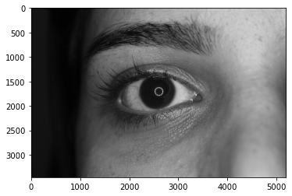
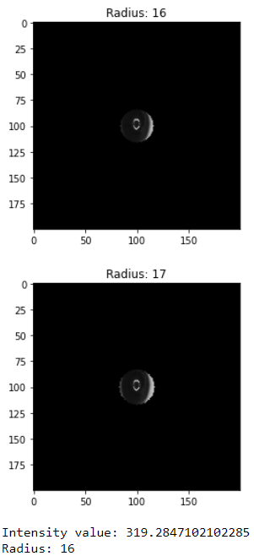
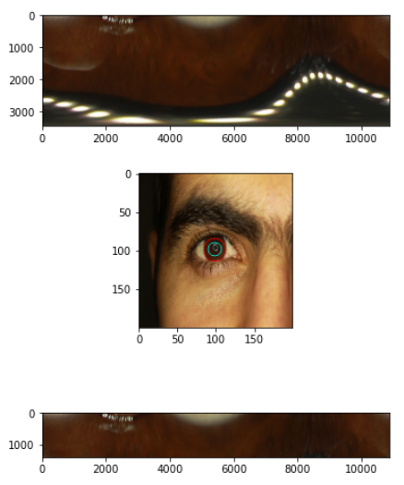
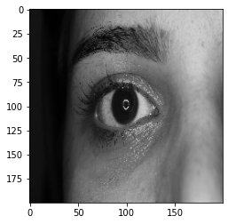
Visual steps of how daugman works

Slide 17
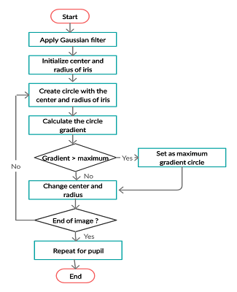
summary

